Slide 1
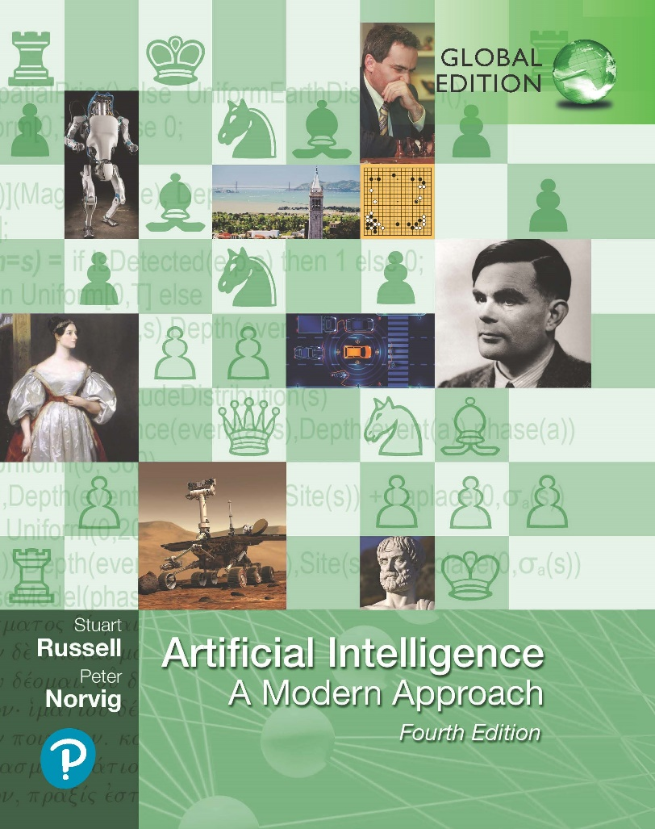
Adversarial Search And Games
Artificial Intelligence: A Modern Approach
Fourth Edition, Global Edition
Chapter 6
© 2022 Pearson Education Ltd.

Slide 2
Outline
Game Theory
Optimal Decisions in Games
minimax decisions
α–β pruning
Monte Carlo Tree Search (MCTS)
Resource limits and approximate evaluation
Games of chance
Games of imperfect information
Limitations of Game Search Algorithms
© 2022 Pearson Education Ltd.

Slide 3
Games Theory
Two players
Max-min
Taking turns, fully observable
Moves: Action
Position: state
Zero sum:
good for one player, bad for another
No win-win outcome.
© 2022 Pearson Education Ltd.

Slide 4
Games Theory
S₀: The initial state of the game
TO-MOVE(s): player to move in state s.
ACTIONS(s): The set of legal moves in state s.
RESULT(s, a): The transition model, resulting state
IS-TERMINAL(s): A terminal test to detect when the game is over
UTILITY(s; p): A utility function (objective/payoff)
© 2022 Pearson Education Ltd.

Slide 5
Games vs. search problems
“Unpredictable” opponent ⇒ solution is a strategy specifying a move for every possible opponent reply
Time limits ⇒ unlikely to find goal, must approximate Plan of attack:
Computer considers possible lines of play (Babbage, 1846)
Algorithm for perfect play (Zermelo, 1912; Von Neumann, 1944)
Finite horizon, approximate evaluation (Zuse, 1945; Wiener, 1948;
Shannon, 1950)
First chess program (Turing, 1951)
Machine learning to improve evaluation accuracy (Samuel, 1952–57)
Pruning to allow deeper search (McCarthy, 1956)
© 2022 Pearson Education Ltd.

Slide 6
Types of games
deterministic chance
perfect information
imperfect information
chess, checkers, go, othello | backgammon monopoly
battleships, blind tictactoe | bridge, poker, scrabble nuclear war
© 2022 Pearson Education Ltd.

Slide 7
Game tree (2-player, deterministic, turns)
MAX (X)
X
 | X
 |  | X
X
 |  | X
X
 | X
 |  | X
MIN (O)
X
X
O
X |  | O
X
O
. . .
MAX (X)
X
O
X
X | O
X
X | O
 | X
. . .
MIN (O)
. . .
. . .
. . .
. . .
X | O |  | X
O | O |  | X
X | X |  | O
X | O |  | X
 | X
X | O |  | O
X O X
. . .
TERMINAL
O X
O
Utility
−1
0
+1
© 2022 Pearson Education Ltd.

Slide 8
Minimax
Perfect play for deterministic, perfect-information games
Idea: choose move to position with highest minimax value
= best achievable payoff against best play
E.g., 2-ply game:
MAX
3
A ₁
A ₂
A ₃
MIN
3
2
2
^{A} 11 ^{A} 12 ^{A} 13
^{A} 21 ^{A} 22
^{A} 23
^{A} 31 ^{A} 32 ^{A} 33
3
12 8 2 4 6 14 5
2
© 2022 Pearson Education Ltd.

Slide 9
Minimax algorithm
function Minimax-Decision(state) returns an action
inputs: state, current state in game
return the a in Actions(state) maximizing Min-Value(Result(a, state))
function Max-Value(state) returns a utility value
if Terminal-Test(state) then return Utility(state)
v ← −∞
for a, s in Successors(state) do v ← Max(v, Min-Value(s))
return v
function Min-Value(state) returns a utility value
if Terminal-Test(state) then return Utility(state)
v ← ∞
for a, s in Successors(state) do v ← Min(v, Max-Value(s))
return v
© 2022 Pearson Education Ltd.

Slide 10
Properties of minimax
Complete??
© 2022 Pearson Education Ltd.

Slide 11
Properties of minimax
Complete?? Only if tree is finite (chess has specific rules for this).
NB a finite strategy can exist even in an infinite tree!
Optimal??
© 2022 Pearson Education Ltd.

Slide 12
Properties of minimax
Complete?? Yes, if tree is finite (chess has specific rules for this)
Optimal?? Yes, against an optimal opponent. Otherwise?? Time complexity??
© 2022 Pearson Education Ltd.

Slide 13
Properties of minimax
Complete?? Yes, if tree is finite (chess has specific rules for this)
Optimal?? Yes, against an optimal opponent. Otherwise?? Time complexity?? O(b^{m})
Space complexity??
© 2022 Pearson Education Ltd.

Slide 14
Properties of minimax
Complete?? Yes, if tree is finite (chess has specific rules for this)
Optimal?? Yes, against an optimal opponent. Otherwise?? Time complexity?? O(b^{m})
Space complexity?? O(bm) (depth-first exploration) For chess, b ≈ 35, m ≈ 100 for “reasonable” games
⇒ exact solution completely infeasible
But do we need to explore every path?
© 2022 Pearson Education Ltd.

Slide 15
α–β pruning example
MAX
3
MIN
3
3
12 8
© 2022 Pearson Education Ltd.

Slide 16
α–β pruning example
MAX
3
MIN
3
2
X X
3
12 8 2
© 2022 Pearson Education Ltd.

Slide 17
α–β pruning example
MAX
3
MIN
3
2
14
X X
3
12 8 2
14
© 2022 Pearson Education Ltd.

Slide 18
α–β pruning example
MAX
3
MIN
3
2
14 5
X X
3
12 8 2
14 5
© 2022 Pearson Education Ltd.

Slide 19
α–β pruning example
MAX
3 3
MIN
3
2
14 5 2
X X
3
12 8 2
14 5
2
© 2022 Pearson Education Ltd.

Slide 20
Why is it called α–β?
MAX
MIN
..
..
..
MAX
MIN
V
α is the best value (to max) found so far off the current path
If V is worse than α, max will avoid it ⇒ prune that branch Define β similarly for min
© 2022 Pearson Education Ltd.

Slide 21
The α–β algorithm
function Alpha-Beta-Decision(state) returns an action
return the a in Actions(state) maximizing Min-Value(Result(a, state))
function Max-Value(state, α, β) returns a utility value
inputs: state, current state in game
α, the value of the best alternative for max along the path to state
β, the value of the best alternative for min along the path to state
if Terminal-Test(state) then return Utility(state)
v ← −∞
for a, s in Successors(state) do
v ← Max(v, Min-Value(s, α, β))
if v ≥ β then return v
α ← Max(α, v)
return v
function Min-Value(state, α, β) returns a utility value
same as Max-Value but with roles of α, β reversed
© 2022 Pearson Education Ltd.

Slide 22
Properties of α–β
Pruning does not affect final result
Good move ordering improves effectiveness of pruning With “perfect ordering,” time complexity = O(b^{m/2})
⇒ doubles solvable depth
A simple example of the value of reasoning about which computations are relevant (a form of metareasoning)
Unfortunately, 35⁵⁰ is still impossible!
© 2022 Pearson Education Ltd.

Slide 23
Monte Carlo Tree Search
The basic Monte Carlo Tree Search (MCTS) strategy does not use a heuristic evaluation function. Value of a state is estimated as the average utility over number of simulations
Playout: simulation that chooses moves until terminal position reached.
Selection: Start of root, choose move (selection policy) repeated moving down tree
Expansion: Search tree grows by generating a new child of selected node
Simulation: playout from generated child node
Back-propagation: use the result of the simulation to update all the search tree nodes going up to the root

Slide 24
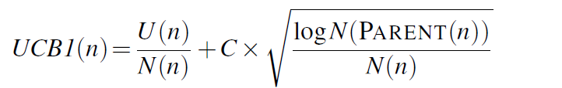
Monte Carlo Tree Search
UCT: Effective selection policy is called “upper confidence bounds applied to trees”
UCT ranks each possible move based on an upper confidence bound formula UCT
called UCB1
where U(n) is the total utility of all playouts that went through node n, N(n) is the number of playouts through node n, and PARENT(n) is the parent node of n in the tree.

Slide 25
Monte Carlo Tree Search
function MONTE-CARLO-TREE-SEARCH(state) returns an action
tree ← NODE(state)
while IS-TIME-REMAINING() do
leaf ← SELECT(tree)
child ← EXPAND(leaf )
result ← SIMULATE(child)
BACK-PROPAGATE(result, child)
return the move in ACTIONS(state) whose node has highest number of playouts

Slide 26
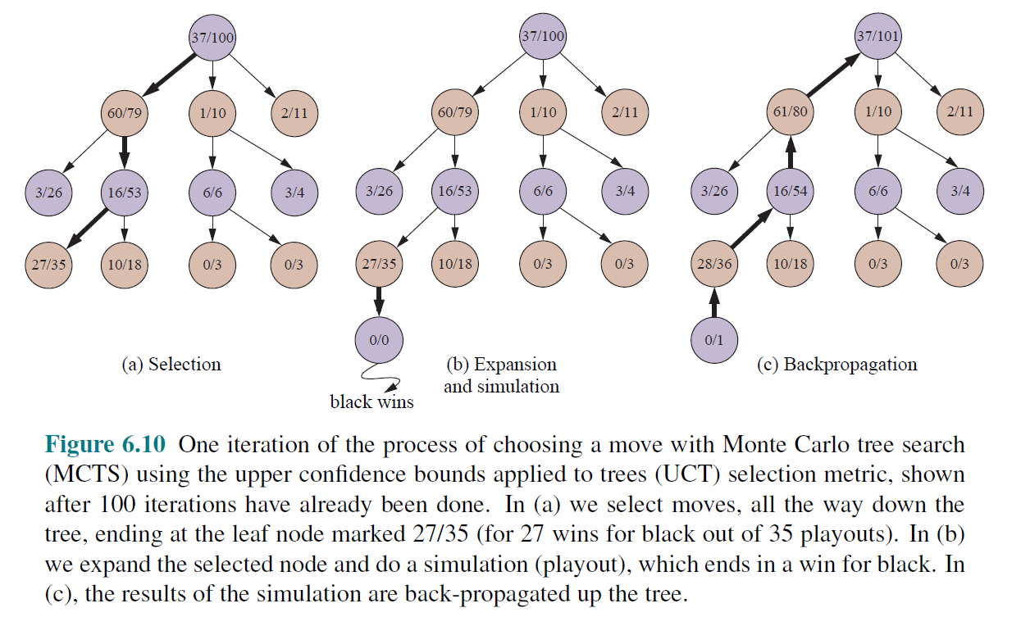
Monte Carlo Tree Search

Slide 27
Resource limits
Standard approach:
Use Cutoff-Test instead of Terminal-Test
e.g., depth limit (perhaps add quiescence search)
Use Eval instead of Utility
i.e., evaluation function that estimates desirability of position
Suppose we have 100 seconds, explore 10⁴ nodes/second
⇒ 10⁶ nodes per move ≈ 35^{8/2}
⇒ α–β reaches depth 8 ⇒ pretty good chess program
© 2022 Pearson Education Ltd.

Slide 28















Evaluation functions
Black to move
White slightly better
White to move
Black winning
For chess, typically linear weighted sum of features
Eval(s) = w₁f₁(s) + w₂f₂(s) + . . . + w_{n}f_{n}(s)
e.g., w₁ = 9 with
f₁(s) = (number of white queens) – (number of black queens),
etc.
© 2022 Pearson Education Ltd.

Slide 29
Digression: Exact values don’t matter
MAX
MIN | 1 |  | 2 |  | 1 |  | 20
 | 1 | 2 | 2 | 4 | 1 | 20 | 20 | 400
Behaviour is preserved under any monotonic transformation of Eval
Only the order matters:
payoff in deterministic games acts as an ordinal utility function
© 2022 Pearson Education Ltd.

Slide 30
Deterministic games in practice
Checkers: Chinook ended 40-year-reign of human world champion Marion Tinsley in 1994. Used an endgame database defining perfect play for all positions involving 8 or fewer pieces on the board, a total of 443,748,401,247 positions.
Chess: Deep Blue defeated human world champion Gary Kasparov in a six- game match in 1997. Deep Blue searches 200 million positions per second, uses very sophisticated evaluation, and undisclosed methods for extending some lines of search up to 40 ply.
Othello: human champions refuse to compete against computers, who are too good.
Go: human champions refuse to compete against computers, who are too bad. In go, b > 300, so most programs use pattern knowledge bases to suggest plausible moves.
© 2022 Pearson Education Ltd.

Slide 31

Nondeterministic games: backgammon
0 1 2 3 4 5 6 7 8 9 10 11 12
25 24 23 22 21 20 19 18 17 16 15 14 13
© 2022 Pearson Education Ltd.

Slide 32
Nondeterministic games in general
In nondeterministic games, chance introduced by dice, card-shuffling
Simplified example with coin-flipping:
MAX
CHANCE
3
−1
0.5
0.5
0.5
0.5
MIN
2
4
0
−2
2 4 7 4 6 0 5 −2
© 2022 Pearson Education Ltd.

Slide 33
Algorithm for nondeterministic games
Expectiminimax gives perfect play
Just like Minimax, except we must also handle chance nodes:
. . .
if state is a Max node then
return the highest ExpectiMinimax-Value of Successors(state)
if state is a Min node then
return the lowest ExpectiMinimax-Value of Successors(state)
if state is a chance node then
return average of ExpectiMinimax-Value of Successors(state)
. . .
© 2022 Pearson Education Ltd.

Slide 34
Nondeterministic games in practice
Dice rolls increase b: 21 possible rolls with 2 dice Backgammon ≈ 20 legal moves (can be 6,000 with 1-1 roll)
3 9
depth 4 = 20 × (21 × 20) ≈ 1.2 × 10
As depth increases, probability of reaching a given node shrinks
⇒ value of lookahead is diminished
α–β pruning is much less effective
TDGammon uses depth-2 search + very good Eval
≈ world-champion level
© 2022 Pearson Education Ltd.

Slide 35
Digression: Exact values DO matter
MAX
DICE
2.1
1.3
21
40.9
.9
.1
.9
.1
.9
.1
.9
.1
MIN
2
3
1
4
20
30
1
400
2 2 3 3 1 1 4 4 20 20 30 30 1 1 400 400
Behaviour is preserved only by positive linear transformation of Eval
Hence Eval should be proportional to the expected payoff
© 2022 Pearson Education Ltd.

Slide 36
Games of imperfect information
E.g., card games, where opponent’s initial cards are unknown
Typically we can calculate a probability for each possible deal
Seems just like having one big dice roll at the beginning of the game∗ Idea: compute the minimax value of each action in each deal,
then choose the action with highest expected value over all deals∗
Special case: if an action is optimal for all deals, it’s optimal.∗ GIB, current best bridge program, approximates this idea by
generating 100 deals consistent with bidding information
picking the action that wins most tricks on average
© 2022 Pearson Education Ltd.

Slide 37
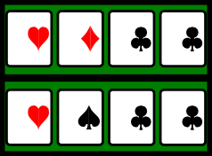
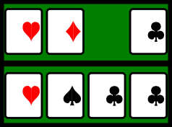
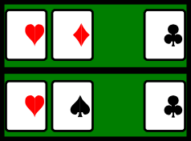
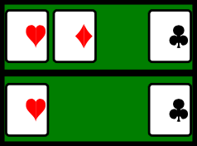
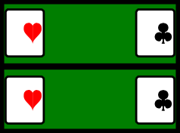
Example
Four-card bridge/whist/hearts hand, Max to play first
8
6
6 6 8 7 6 6 7 6 6 7 6 6 7
6
7
0
4 2 9 3 4 2 9 3 ₉ 4 2 3 ₂ 4 3
4
3
© 2022 Pearson Education Ltd.

Slide 38
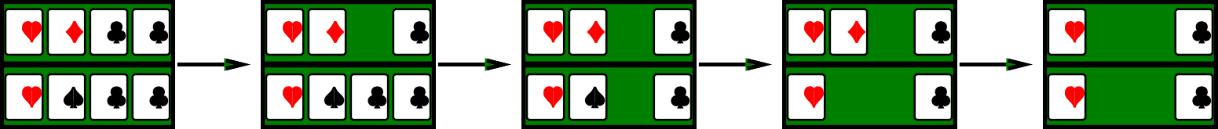
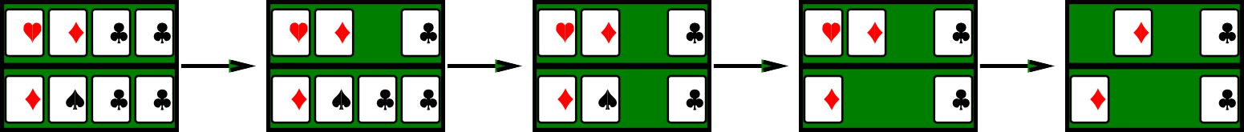
Example
Four-card bridge/whist/hearts hand, Max to play first
8
6
MAX 6 6 8 7 6 6 7 6 6 7 6 6
7
6
7
0
MIN 4 2 9 3 4 2 9 3 ₉ 4 2 3 ₂ 4
3
4
3
MAX
6 6 8 7
8
6 6
7
6 6
7
6 6
7
6
6
7
0
MIN 4 2 9 3
4 2 9 3
9
4 2
3
2
4
3
4
3
© 2022 Pearson Education Ltd.

Slide 39
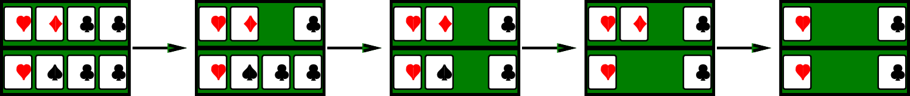
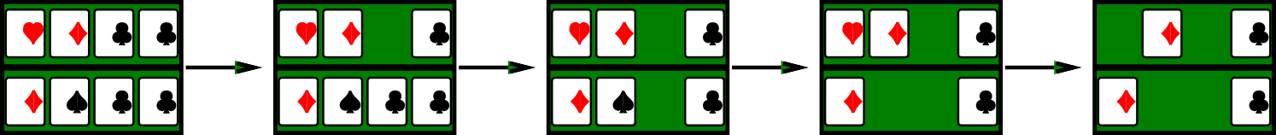
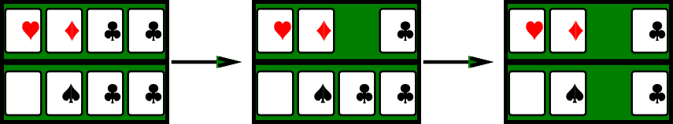
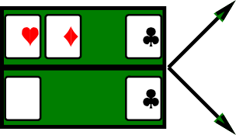
Example
Four-card bridge/whist/hearts hand, Max to play first
8
6
MAX 6 6 8 7 6 6 7 6 6 7 6 6 7
6
7
0
MIN 4 2 9 3 4 2 9 3 ₉ 4 2 3 ₂ 4 3
4
3
MAX 6 6 8 7
8
6 6
7
6 6
7
6 6
7
6
6
7
0
MIN 4 2 9 3
4 2 9 3
9
4 2
3
2
4
3
4
3
6 | 6 | 7
 | 4 | 3
 | 6 | 7
6 | 4 | 3
−0.5
MAX 6 6 8 7
8
6 6
7
6 6
7
6 6
7
MIN 4 2 9 3
4 2 9 3
9
4 2
3
2
4
3
−0.5
© 2022 Pearson Education Ltd.

Slide 40
Common sense example
Road A leads to a small heap of gold pieces Road B leads to a fork:
take the left fork and you’ll find a mound of jewels; take the right fork and you’ll be run over by a bus.
© 2022 Pearson Education Ltd.

Slide 41
Common sense example
Road A leads to a small heap of gold pieces Road B leads to a fork:
take the left fork and you’ll find a mound of jewels; take the right fork and you’ll be run over by a bus.
Road A leads to a small heap of gold pieces Road B leads to a fork:
take the left fork and you’ll be run over by a bus; take the right fork and you’ll find a mound of jewels.
© 2022 Pearson Education Ltd.

Slide 42
Common sense example
Road A leads to a small heap of gold pieces Road B leads to a fork:
take the left fork and you’ll find a mound of jewels; take the right fork and you’ll be run over by a bus.
Road A leads to a small heap of gold pieces Road B leads to a fork:
take the left fork and you’ll be run over by a bus; take the right fork and you’ll find a mound of jewels.
Road A leads to a small heap of gold pieces Road B leads to a fork:
guess correctly and you’ll find a mound of jewels; guess incorrectly and you’ll be run over by a bus.
© 2022 Pearson Education Ltd.

Slide 43
Proper analysis
Intuition that the value of an action is the average of its values in all actual states is WRONG
With partial observability, value of an action depends on the information state or belief state the agent is in
Can generate and search a tree of information states Leads to rational behaviors such as
Acting to obtain information
Signalling to one’s partner
Acting randomly to minimize information disclosure
© 2022 Pearson Education Ltd.

Slide 44
Limitations of Game Search Algorithms
Alpha–beta search vulnerable to errors in the heuristic function.
Waste of computational time for deciding best move where it is obvious (meta-reasoning).
Reasoning done on individual moves. Humans reason on abstract levels.
Possibility to incorporate Machine Learning into game search process.
© 2022 Pearson Education Ltd.

Slide 45
Summary
Minimax algorithm: selects optimal moves by a depth-first enumeration of the game tree.
Alpha–beta algorithm: greater efficiency by eliminating subtrees
Evaluation function: a heuristic that estimates utility of state.
Monte Carlo tree search (MCTS): no heuristic, play game to the end with rules and repeated multiple times to determine optimal moves during playout.
© 2022 Pearson Education Ltd.

